Slide 1
Introduction to PostgreSQL

Slide 2


Hello!
I AM HOWIE REITH
Software Developer
Howard.Reith@gmail.com

Slide 3
Contents
Installation and Overview
CRUD
JOINs
Indexing
Aggregate Functions
Transactions

Slide 4
Installation and Overview
1

Slide 5
Installation
Go to
http://www.postgresql.org/download/
Follow the instructions for your operating system.
This tutorial is using Ubuntu 20.04 via Windows Subsystem for Linux.

Slide 6
CRUD
For me, using Linux Ubuntu, I start the server and enter the database with the following commands:
sudo service postgresql start
sudo –u postgres psql
postgres is my admin user name. It may be slightly different for you. Once you have logged in and see postgres=# on your command line, you are ready to go.

Slide 7
Overview
PostgreSQL:
Relational Database Management System (RDBMS)
Based on set theory with two-dimensional tables. You can essentially imagine them as spreadsheets.
In terms of CAP, prioritizes consistency and support ACID transactions.
Oldest, most-trusted, and most widely-used database.
Immense number of features and a massive open source community.

Slide 8
Overview
We'll be building a database for an event planning application.

Slide 9
CRUD
2

Slide 10
CRUD
Create a new table for states in which our events will happen.
CREATE TABLE states (
state_abbr char(2) PRIMARY KEY,
state_name text UNIQUE
);
"states" is the table name.
"state_abbr" and "state_name" are the column headings.
"char", "text", and "varchar" are the three most common types for rows in Postgres.
“PRIMARY KEY” and “UNIQUE” are constraints on these rows. "PRIMARY KEY" will also automatically a assign a clustered index to that column, which we'll discuss soon.
Notes:
"text" is a variable-length string. "varchar" behaves similarly but can have a value added to limit its length. "char" is a fixed-length string, so if the value is shorter than the length, the remainder will be padded with blanks.
PRIMARY KEY is an identifier and thus doesn’t allow duplicate values in the table. Unique applies a similar constraint to state_name. If an update to the DB violates these constraints or types, it will error out and be prevented.

Slide 11
CRUD
Let’s add some data to our states table.
INSERT INTO states (state_abbr, state_name)
VALUES ('ny', 'New York'), ('ma', 'Massachusetts'), ('ca', 'California'),('fl', 'Florida'), ('co', 'Colorado'), ('nv', 'Nevada'), ('cn', 'Canada');
Now let’s make sure our constraints are working.
INSERT INTO states (state_abbr, state_name)
VALUES ('ny', 'New Yankees');
INSERT INTO states (state_abbr, state_name)
VALUES ('fj', 'New York');
INSERT INTO states (state_abbr, state_name)
VALUES ('nyc', 'New York');

Slide 12
CRUD
Now let's make sure all of our rows were inserted correctly.
SELECT * FROM states;
We're told that Canada is not, in fact, a state in the US. Let's remove it.
DELETE FROM states WHERE state_abbr = 'cn';

Slide 13
CRUD
Let's create another table of cities to be inside our states.
CREATE TABLE cities (
name text NOT NULL,
zip_code varchar(9) CHECK (zip_code <> ''),
state_abbr char(2) REFERENCES states,
PRIMARY KEY (state_abbr, zip_code)
);
Again, we've imposed some constraints.
NOT NULL requires that the text not be null, essentially making it required.
"<>" means "not equal," so the zip code cannot be an empty string.
"REFERENCES" constrains a value to be present as a primary key in another table, in this case the states table.
Notes:
You cannot have multiple primary keys on a table due to the nature of clustered indexes, but you can have composite primary keys. This effectively means that any foreign keys to this table must reference both of these columns and renders these required on this table.

Slide 14
CRUD
Now let's try adding a city.
INSERT INTO cities
VALUES ('Las Vegas', '88901', 'nv');
And let's make sure our constraints work.
INSERT INTO cities
VALUES ('Boston', '02101', '');
INSERT INTO cities
VALUES ('Boston', '', 'ma');

Slide 15
CRUD
Las Vegas has many zip codes. Let's say we've decided we want to store a different one with the city. Let's perform an update.
UPDATE cities
SET zip_code = '89128'
WHERE name = 'Las Vegas';

Slide 16
CRUD
Exercise:
We've now performed all four CRUD actions: creating, reading, updating, and deleting. On your own, perform each of these actions with your own city of choice. Add it to the database, retrieve it, change its zip code, and then delete it.

Slide 17
JOINs
3

Slide 18
JOINs
The JOIN operation is perhaps the single greatest appeal of relational databases. Almost all DBs can do the various CRUD actions we've done so far. JOINs allow us to combine different tables in interesting ways unleashing the varied queryability for which we go to RDBMSs.
In preparation, let's add a few more cities to our cities table.
INSERT INTO cities
VALUES ('Boston', '02101', 'ma'), ('New York City', '01001', 'ny'), ('Los Angeles', '90001', 'ca'), ('San Francisco', '94016', 'ca');

Slide 19
JOINs
Let's perform our first INNER JOIN.
SELECT cities.*, state_name
FROM cities INNER JOIN states
ON cities.state_abbr = states.state_abbr;
All joins return tables that, in some fashion, combine the values of the tables specified. In our SELECT statement, we specify what we want to be included in our new table. "cities.*" means "all of the columns in the cities table." Then we add in "state_name" from the states table. The ON statement specifies the column we want to match by. In this case, we are basically saying "give me all of the rows where the state abbreviations match between these tables and show me all the city info plus the name of the state the city is in."

Slide 20
JOINs
Las Vegas, NV Boston, MA New York City, NY
Los Angeles, CA San Francisco, CA
CO FL

Slide 21
JOINs
Now let's experiment with the other joins.
SELECT cities.*, state_name
FROM cities LEFT JOIN states
ON cities.state_abbr = states.state_abbr;
LEFT JOIN or LEFT OUTER JOIN will return all the contents of the first table (cities) and the overlap. Due to the way we set up our constraints, this result will be identical to the inner join with these tables.
SELECT cities.*, state_name
FROM cities RIGHT JOIN states
ON cities.state_abbr = states.state_abbr;
RIGHT JOIN or RIGHT OUTER JOIN will return all the contents of the joined table (states) and the overlap.

Slide 22
JOINs
Las Vegas, NV Boston, MA New York City, NY
Los Angeles, CA San Francisco, CA
CO FL

Slide 23
JOINs
Las Vegas, NV Boston, MA New York City, NY
Los Angeles, CA San Francisco, CA
CO FL

Slide 24
JOINs
FULL OUTER JOIN will return absolutely everything in both tables, even if there are null values in one.
SELECT cities.*, state_name
FROM cities FULL OUTER JOIN states
ON cities.state_abbr = states.state_abbr;

Slide 25
JOINs
Las Vegas, NV Boston, MA New York City, NY
Los Angeles, CA San Francisco, CA
CO FL

Slide 26
JOINs
If we want to see only the parts that don't overlap, we can do that by introducing a WHERE clause.
SELECT cities.*, state_name
FROM cities LEFT OUTER JOIN states
ON cities.state_abbr = states.state_abbr WHERE states.state_abbr IS NULL;
SELECT cities.*, state_name
FROM cities RIGHT OUTER JOIN states
ON cities.state_abbr = states.state_abbr WHERE cities.state_abbr IS NULL;
SELECT cities.*, state_name
FROM cities FULL OUTER JOIN states
ON cities.state_abbr = states.state_abbr WHERE cities.state_abbr IS NULL
OR states.state_abbr IS NULL;

Slide 27
JOINs
Las Vegas, NV Boston, MA New York City, NY
Los Angeles, CA San Francisco, CA
CO FL

Slide 28
JOINs
Las Vegas, NV Boston, MA New York City, NY
Los Angeles, CA San Francisco, CA
CO FL

Slide 29
JOINs
Las Vegas, NV Boston, MA New York City, NY
Los Angeles, CA San Francisco, CA
CO FL

Slide 30
JOINs
Let's add a "venues" table where our events will take place.
CREATE TABLE venues (
venue_id SERIAL PRIMARY KEY,
name text,
address text,
zip_code varchar(9),
state_abbr char(2),
FOREIGN KEY (state_abbr, zip_code)
REFERENCES cities (state_abbr, zip_code) MATCH FULL
);
SERIAL PRIMARY KEY will automatically increment integers (1, 2, 3, etc.), a common (and best practice) way to assign primary keys.
FOREIGN KEY establishes a link between this table and our cities table via its two primary keys.
MATCH FULL requires that either both keys be present or both null.

Slide 31
JOINs
Let's populate our venues table.
INSERT INTO venues (name, address, zip_code, state_abbr)
VALUES ('Courtside', '291 Cambridge Street', '02101', 'ma'), ('Banana Land', '54 Peel Lane', '94016', 'ca');
And see what we've got.
SELECT * FROM venues;
Notice the venue_id has automatically been populated.
Let's also just illustrate our MATCH FULL constraint.
INSERT INTO venues (name, address, zip_code)
VALUES ('Narnia', 'That wardrobe', '5555');

Slide 32
JOINs
Challenge
Create an Events table with the following columns:
event_id, Name, Starts, Ends, venue_id
The event_id should auto-increment and the venue_id should be a foreign key linking to the venues table. Name, starts, and ends should all be required basic text.
Hint: Serial primary keys produce an INTEGER type
Populate your new Events table with three events. One should have no venue. Dates should be formatted as YYYY-MM-DD hh:mm:ss
Write a query that retrieves all information about an event at a given venue based on the venue's name. The returned table should also include the venue's address.

Slide 33
JOINs
Solution
CREATE TABLE events (
event_id SERIAL PRIMARY KEY,
name text NOT NULL,
starts text NOT NULL,
ends text NOT NULL,
venue_id INTEGER,
FOREIGN KEY (venue_id)
REFERENCES venues (venue_id)
);
Continues on next slide...

Slide 34
JOINs
Solution.
INSERT INTO events (name, starts, ends, venue_id)
VALUES ('Karaoke Night', '2020-08-15 21:00:00', '2020-08-15 23:59:59', 1), ('Banana Shake', '2020-08-15 12:00:00', '2020-08-15 01:00:00', 2);
INSERT INTO events (name, starts, ends)
VALUES ('Halloween', '2020-10-31 00:00:00', '2020-10-31 23:59:59');
SELECT events.*, venues.address
FROM events INNER JOIN venues
ON events.venue_id = venues.venue_id
WHERE venues.name = 'Courtside';

Slide 35
JOINs
This is an Entity Relationship Diagram (ERD). It illustrates how the tables are connected. The pronged lines indicate a "one-to-many" relationship, e.g., "venues have many events."
States
state_abbr
state_name
Cities
name
zip_code
state_abbr
Events
event_id
name
starts
ends
venue_id
Venues
venue_id
name
address
zip_code
state_abbr

Slide 36
Indexing
4

Slide 37
Indexing
Indexing is just what it sounds like - a referencing method that speeds up your database's ability to find desired information. To understand it, you need to know how Postgres stores data.
Terminology:
Filenode: An ID which represents a reference to a table or an index.
Page: A usually 8 Kb segment of information stored on the disk.
Heap File: Lists of unordered records of variable size. These are not the same as a heap data structure.
Database Cluster: A collection of databases managed by the database server, essentially the database storage area on the disk.
Tuple: Essentially, a row in the database.

Slide 38
Indexing
Each table in your database is stored in a separate file. This file consists of an array of pages which are of fixed size, usually 8 kilobytes. All pages are logically equivalent so any given row on your table can be stored on any page. Pages are organized into heap files, each containing a collection of items (rows). Pointers to items are stored at the front of the page while the items themselves are stored at the end of the page. All rows in the database will be of the same byte length, which is why we can be confident in their locations on disk. There are additional headers at the front of the page we won't get into because they're not important to understand indexes.

Slide 39
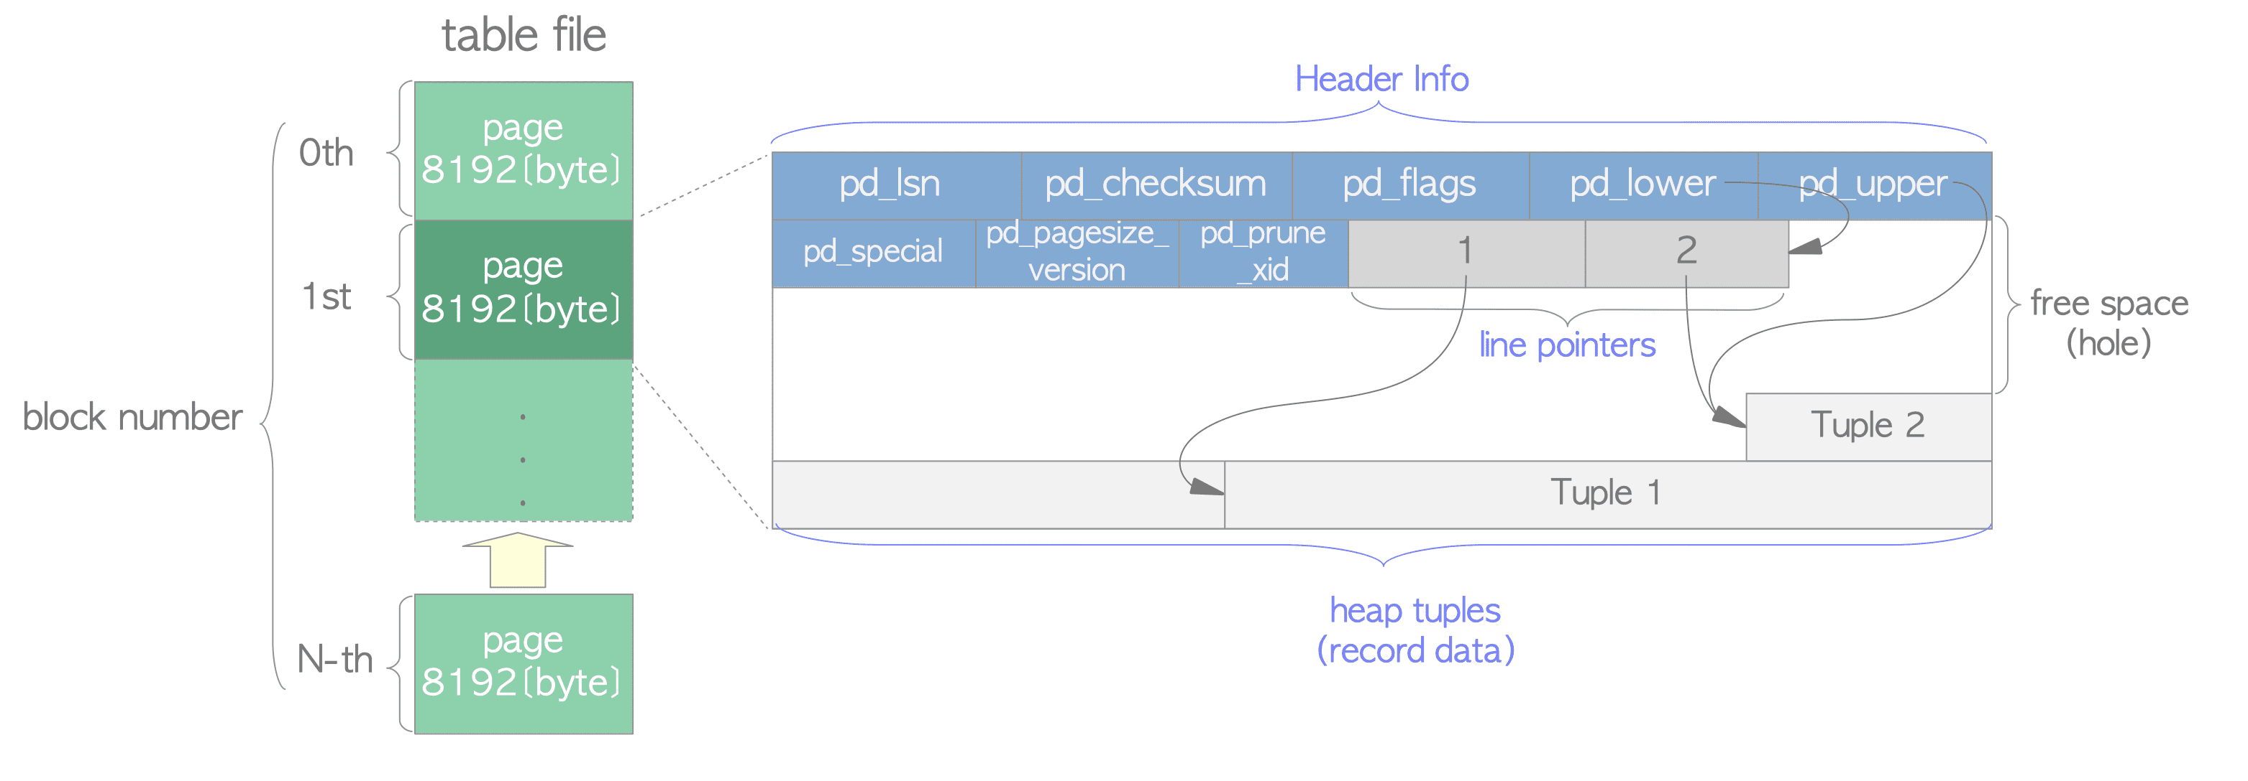
Indexing
Source: http://www.interdb.jp/pg/pgsql01.html

Slide 40
Indexing
Primary Key Index
When you create a primary key, you create what is called a clustered index. A clustered index is essentially sorting the data on disk according to the column by which you're indexing. This is why retrieving an item by primary key is the fastest lookup you can do; you are looking for the exact spot as organized on disk. This is also why you can only have one primary key and why it's a best practice for it to auto-increment. If you're inserting a new value in the middle of your clustered index, you will be moving all of your data to a new spot on your hard drive.

Slide 41
Indexing
When we create any other besides a clustered index index, we are creating a list of key value pairs where the keys are the values of the items we are looking to index and the values are the locations of those items. These locations constitute the page and the index of the desired item. These key value stores are sorted by their keys thus allowing us to employ efficient search algorithms to locate their true values on the disk. By default, these indexes are arranged as B Trees, thus allowing us to perform binary search to retrieve our values. Indexes can be stored as additional data structures as well, including hash tables.

Slide 42
Indexing
[
{ apples: page 2, index 5 },
{ bananas: page 3, index 1 },
{ grapes: page 1, index 10 },
{ oranges: page 5, index 2 }
]

Slide 43
Indexing
Disadvantages of Indexes:
Indexes take up more space. This doesn't only mean hard drive space; it means RAM too.
You must be aware of how these indexes are being stored on disk in regard to spatial locality. If the values by which you're indexing are distantly located on your disk. your index could make your reads slower.
Generally speaking, indexes only value if you are doing more reads than writes. With every write and delete, your indexes will need to be updated and all trees rebalanced. With a B Tree index for example, you're effectively turning your reads from O(x) to O(logx), but you're also turning your writes from O(1) to O(logx) as well. If your use case is more focused on writing, like a logging DB, indexes are poison.

Slide 44
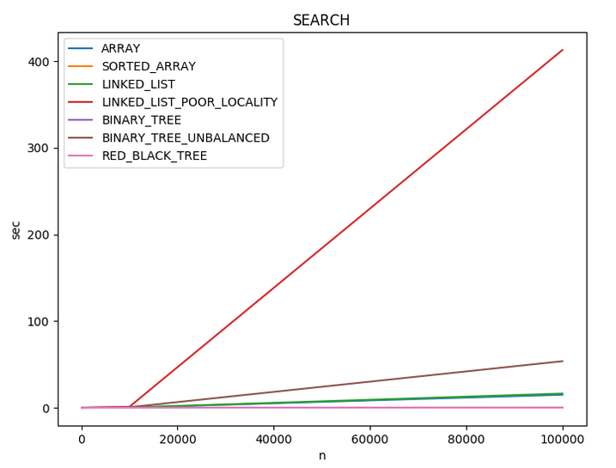
Indexing
Source: https://hideoushumpbackfreak.com/algorithms/list-data-struct-actual-run-times

Slide 45
Indexing
Let's add an index to our events table.
CREATE INDEX events_name
ON events USING hash (name);
A hash index is only capable of equality evaluations on a single field, however it takes up less space and has a constant time lookup operation (vs. O(logn) for a B Tree). It's superior for our use case here, so we're using it.
Let's add binary tree indexes for our start dates as well.
CREATE INDEX events_starts
ON events (starts);
Now when we look up events by name or date, we won't need to iterate through the entire list.

Slide 46
Aggregate Functions
5

Slide 47
Aggregate Functions
Aggregate functions combine the results of queries across many rows into a single returned collection of data. The simplest of the aggregate functions is the count() function.
SELECT count(*)
FROM events;
The value in the parentheses is the columns on which to count. With *, we are including all columns, but we can be more specific.
SELECT count(name)
FROM events
WHERE name LIKE 'Halloween%';
The LIKE operator looks for approximate match, and the % is a wildcard. This query would find Halloween, Halloween Day, etc. Underscore (_) will match any single character and ILIKE works the same as LIKE but ignores case.

Slide 48
Aggregate Functions
Let's add some more data to our database to prepare for the next query.
INSERT INTO events (name, starts, ends, venue_id)
VALUES ('Karaoke Sunday', '2020-09-16 20:00:00', '2020-08-16 22:00:00', 1), ('Disney Karaoke', '2020-08-17 20:00:00', '2020-08-17 22:00:00', 1);
Now let's find out how long Courtside's been doing karaoke. Let's retrieve from the database the earliest start time and the latest end time for all events at Courtside.
SELECT min(starts), max(ends)
FROM events INNER JOIN venues
ON events.venue_id = venues.venue_id
WHERE venues.name = 'Courtside';

Slide 49
Aggregate Functions
Let's say we wanted to count the events at each venue. To do this, we would seemingly need to write a whole bunch of SELECT statements for each venue.
SELECT count(*) FROM events WHERE venue_id = 1;
SELECT count(*) FROM events WHERE venue_id = 2;
SELECT count(*) FROM events WHERE venue_id = 3;
etc....
Fortunately, Postgres has a process for doing this in a syntactically simple manner, the GROUP BY function. If you're familiar with the Pivot Table concept in excel or similar tools, GROUP BY is similar.
SELECT venue_id, count(*)
FROM events
GROUP BY venue_id;

Slide 50
Aggregate Functions
What if we wanted to find all venues that exist (are not null) and have more than one event? I.e., the most popular venues according to where the most parties are happening. We can't use WHERE with aggregate functions, but GROUP BY has a keyword called HAVING that works like the WHERE clause for this purpose.
SELECT venue_id, count(*)
FROM events
GROUP BY venue_id
HAVING count(*) >= 2 AND venue_id IS NOT NULL;
As a best practice, avoid using GROUP BY on values other than primary keys. This will assure the values you're grouping by are unique and minimize the amount of frantic motion around the disk your DB need do to collect all the data.

Slide 51
Aggregate Functions
Lastly, one common use of GROUP BY is to get all unique values from a column.
SELECT venue_id FROM events GROUP BY venue_id;
This is so common that Postgres has a shortcut for it: DISTINCT
SELECT DISTINCT venue_id FROM events;

Slide 52
Aggregate Functions
To summarize:
The simplest aggregate function is the COUNT() function.
To aggregate a list of data about a variety of rows, use GROUP BY.
To filter through the items you've GROUP BY'd, use HAVING.
If you want to find all unique entries in a table, use SELECT DISTINCT.

Slide 53
Transactions
6

Slide 54
Transactions
Transactions are one of the most important aspects of relational databases, as they are what achieves the high level of consistency for which many go to the model. Transactions guarantee that every command in your query is executed, and if anything fails, the entire procedure is rolled back. PostgreSQL transactions are ACID compliant. Thus far, every command we've run has been implicitly wrapped in a transaction. They are built into the structure of the database.

Slide 55
Transactions
You can explicitly begin a transaction with BEGIN TRANSACTION. You can terminate it with ROLLBACK; otherwise it ends with END.
BEGIN TRANSACTION;
DELETE FROM events;
ROLLBACK;
SELECT * FROM events;
As you can see, none of our events were deleted.
Transactions are most common when you're modifying multiple tables that you want to keep in sync. Standard example is when you want to pull money out of one account and deposit it in another.
BEGIN TRANSACTION;
UPDATE account SET value = value + 200 WHERE account_id=1;
UPDATE account SET value = value - 200 WHERE account_id=2;
END;

Slide 56
Transactions
When modifying the database in a transaction, Postgres will prevent any other user from modifying that part of the database.
Let's run this code in one window.
BEGIN TRANSACTION;
UPDATE events SET location_id = 1 WHERE event_id = 3;
In another window, if I modify any other row.
UPDATE events SET location_id = 2 WHERE event_id = 1;
It goes through fine. But if I try to modify the event at event_id 3
UPDATE events SET location_id = 2 WHERE event_id = 3;
It hangs up. It won't let me change it until I end the transaction in the other window.
END;

Slide 57
Bibliography
Seven Databases in Seven Weeks by Perkins, Redmond, and Wilson
Postgres Docs - Index Types
PostgreSQL Indexing - How, Why, and When

Slide 58
Thanks for watching!
ANY QUESTIONS?
You can contact me at
Howard.Reith@gmail.com

